Slide 1


Network & System Administration
Disaster Recovery and Business Continuity

Slide 2
Week | 9th Week
Day
Duration | 4hrs
Agenda
TIME | TOPIC & ACTIVITY | CPMPLETED-
30 Mins | Backup strategies and disaster recovery planning | Yes/No
60 Mins | High availability and fault tolerance | Yes/No
15 Mins | Break | Yes/No
45 Mins | Business continuity planning and testing | Yes/No
30 Mins | Q&A Session on lesson learnt | Yes/No
15 Mins | Break | Yes/No
60 Mins | IT architecture | Yes/No
15 Mins | Group Discussion | Yes/No

Slide 3
Learning Objectives
9.1 Backup Strategies and Disaster Recovery Planning
9.2 High Availability and Fault Tolerance
9.3 Business Continuity Planning and Testing
9.4 IT Architecture

Slide 4
9.1 Backup strategies and disaster recovery planning

Slide 5
Definition of Disaster recovery plan (DRP)
A disaster recovery plan: what is it? A recorded policy and/or process known as a disaster recovery plan (DRP), disaster recovery implementation plan (DRP), or IT disaster recovery plan is made to help an organization carry out recovery procedures in the event of a disaster to safeguard business IT infrastructure and, in general, to support recovery.
A disaster recovery plan's main goal is to provide a thorough explanation of the coordinated steps that need to be done in advance of, during, and following a natural or man-made disaster, enabling the entire team to carry them out. Both purposeful and unintentional man-made disasters—like the effects of terrorism or hacking—as well as equipment failures should be covered by a disaster recovery plan.

Slide 6
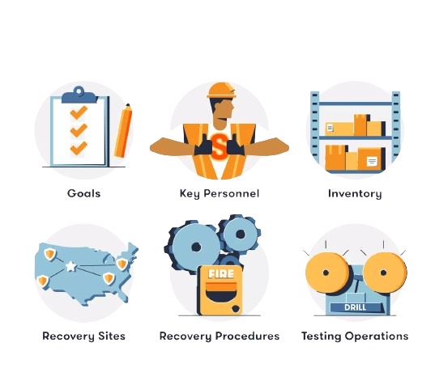
What should a disaster recovery plan include?

Slide 7

What is Business Continuity (BC) ?
The term "business continuity" (BC) describes the policies, practices, and frameworks that a company has put in place to make sure that critical operations can carry on both during and after an emergency or unplanned disruption. BC's major objective is to reduce the effect of disruptions on company operations while maintaining the availability of vital services and functions for clients, staff, and other stakeholders.

Slide 8
Components of Business Continuity
Business Continuity Plan (BCP):
Risk Assessment:
Business Impact Analysis (BIA):
Recovery Strategies:
Incident Response Plan:
Communication Plan:
Training and Testing:

Slide 9
Backup Strategies
Complete Backup
Copying every piece of data from the source to the backup location is called a full backup. This kind of backup is simple to use and gives you a full duplicate of all the data at a certain moment in time.
Pros:
simplifies restore procedures because a single backup set contains all the data.
easiest to maintain because every backup is self-contained.
Cons:
laborious to complete, particularly with big datasets.
needs a large amount of storage space.

Slide 10
Incremental Backup
Only the data that has changed since the last backup, whether full or incremental, is copied in an incremental backup.
Pros:
fastest backup kind since it only contains updated or changed data, saving both time and space.
effective use of bandwidth and storage.
Cons:
restore that is slower and more difficult since each incremental backup made since the last complete backup needs to be applied.
Risk of missing data in the event that a subsequent incremental backup is lost or damaged.

Slide 11
Constant Data Security (CDP)
Continuous data backup, or CDP, records all data modifications in real time so that data can be recovered to any point in time.
Pros:
offers the highest level of data protection with the least amount of data loss in the event of a failure.
provides for granular restore capabilities and allows for recovery to any moment in time.
Cons:
can be resource-intensive, needing large amounts of storage and bandwidth.
more difficult to set up and maintain than conventional backup techniques.

Slide 12
DR Plan Components
Business Impact Analysis (BIA) and Risk Assessment:
Risk assessment: include determining possible threats to the system, such as hardware malfunctions, cyberattacks, natural disasters, or human mistake. The assessment assesses these hazards' likelihood and possible consequences.
Business Impact Analysis (BIA): is a thorough assessment of the ways in which various interruptions could impact a company's operations. Determining the essential business functions and the dependencies that sustain them is helpful. The company Impact Analysis (BIA) measures the possible losses (financial, reputational, and operational) if company operations are disrupted.

Slide 13
DR Plan Components
Recovery Objectives:
Recovery Point Objective (RPO): This establishes the upper limit of allowable data loss expressed in terms of time. It shows the maximum amount of time that data can be restored following a disturbance. An RPO of four hours, for example, indicates that the company is prepared to lose data that could be valued up to four hours.
Recovery Time Objective (RTO): This establishes the utmost allowable downtime following a disturbance for crucial company operations. It specifies the timeframe within which business continuity must be maintained by restoring systems, apps, and procedures. An RTO of two hours, for instance, mandates that the system be operational again after two hours of disturbance.

Slide 14
DR Plan Components
DR Teams and Procedures:
DR Procedures: These are comprehensive, step-by-step guidelines for handling and recovering from different kinds of emergencies. Procedures address things like:
Emergency response: prompt steps taken to guarantee security and minimize harm
Data protection and retrieval
Procedures for system failover and recovery
Protocols for communication and escalation routes
Drills and testing to make sure protocols are current and efficient

Slide 15
DR Plan Components
DR Teams: Different facets of disaster recovery are assigned to distinct teams. Usually, these groups consist of:
Management Team: gives general guidance and makes important choices in times of need.
IT Recovery Team: focuses on technical recovery activities such as application recovery, network re-establishment, and data restoration.
Business Continuity Team: makes sure that corporate operations carry on throughout the process of IT recovery, frequently through the use of interim manual procedures.
Communication Team: oversees all communications, both internal and external, making sure all parties involved are aware of the circumstances and the status of the recovery.
Support Teams: During the recovery phase, take care of logistical support by supplying the required materials and attending to any issues pertaining to human resources.

Slide 16
9.2 High availability and fault tolerance

Slide 17
High Availability (HA)
High Availability (HA) is a term used to describe a system design methodology and related service implementation that guarantees a specific degree of operational performance, usually uptime, for a longer duration than usual. Reducing downtime and maximizing system availability are the two main objectives of HA. This is frequently accomplished by using redundant parts, such networks, servers, and storage, which may take over if a primary part fails. Systems with high availability are built to withstand heavy loads and continue to function even in the event of unplanned malfunctions, repairs, or updates.

Slide 18
Fault Tolerance
The ability of a system to keep working correctly even if some of its components fail is known as fault tolerance. It entails building systems with the ability to identify, isolate, and handle errors—often without causing a disruption in service. The main objective is to keep the system from being disrupted by a single point of failure.

Slide 19
High Availability Techniques and Technologies
Load Balancing: To guarantee that no one server experiences excessive demand, load balancing divides incoming network traffic among several servers. This improves the applications' availability and responsiveness.
Technology
Software load balancers include Apache Traffic Server, HAProxy, and Nginx.
Techniques:
Hardware load balancers: Citrix ADC, A10 Networks, BIG-IP F5 Networks.
AWS Elastic Load Balancing, Azure Load Balancer, and Google Cloud Load Balancing are examples of cloud-based load balancers.
Requests are distributed among the server pool in a round robin fashion.
Reduced Connections: Sends requests to the server that has the least number of open connections.
IP Hash: Ensures that a client is continually directed to the same server by routing requests based on the IP address of the client.
Traffic is routed according to the geographical locations of the client and server via geographic load balancing.

Slide 20
Clustering: Connecting several servers, or nodes, into a cluster allows them to function as a single system with high availability and scalability.
Technology
Database clustering: Oracle Real Application Clusters (RAC) and MySQL Cluster.
Techniques:
With active-active clustering, fault tolerance and performance are increased because all nodes share the load and are active.
Application Server Clustering: WebSphere, Apache Tomcat, JBoss, and modules for clustering.
Clustering File Systems: Ceph, GlusterFS.
In an active-passive cluster, one node is in charge while the other is in reserve, prepared to take over in the event that the active node fails.
Shared: Nothing Clustering: Data is divided across nodes without requiring storage sharing between them. Each node is independent.

Slide 21
Redundancy: Redundancy is the process of duplicating essential parts or features of a system to boost availability and dependability.
Technology
Data redundancy is provided at the storage level using RAID (Redundant Array of Independent Disks).
Techniques:
Hardware redundancy refers to the use of duplicate hardware parts, such as network cards and power supply.
Solutions for Data Replication: rsync, DRBD, and AWS S3 replication.
Hot Standby Router Protocol (HSRP) and Virtual Router Redundancy Protocol (VRRP) are two examples of network redundancy protocols.
Cloud redundancy: AWS, Azure, and Google Cloud deployments across many regions.
Replicating data across several storage systems or geographical locations is known as data redundancy.
In order to prevent single points of failure, network redundancy involves using several network pathways or ISPs.
Using several instances of an application to guarantee availability is known as application redundancy.

Slide 22
9.3 Business continuity planning and testing

Slide 23

Business Continuity Planning (BCP)
An important procedure that helps businesses get ready for, react to, and recover from unforeseen disruptions is business continuity planning, or BCP. Ensuring important business operations can continue both during and after a crisis is the main objective of a business continuity plan (BCP).

Slide 24
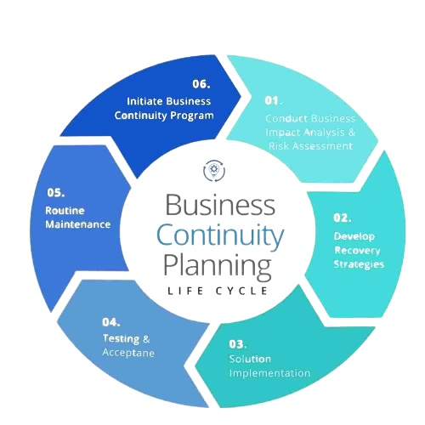
Developing a Business Continuity Plan

Slide 25
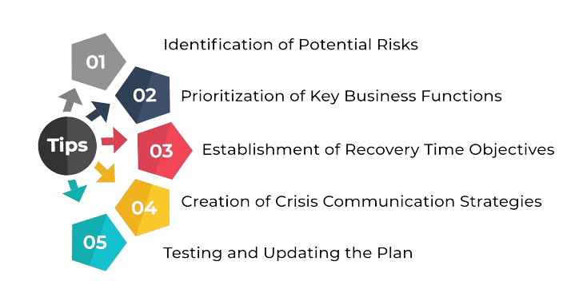
Tips to Consider when Developing a BCP

Slide 26
Assessment and Strategy of BCP
Risk Assessment:
Identify Potential Threats: Recognize and assess every risk that could arise, including pandemics, cyberattacks, and natural disasters.
Assess Vulnerabilities: Identify the organizational vulnerabilities that these attackers might exploit.
Evaluate Impact: Calculate the possible effects of each threat on the finances, reputation, compliance, and business operations.
Strategy Development:
Establish Objectives: Establish specific goals for the BCP, such as reducing downtime, guaranteeing worker safety, and safeguarding property.
Resource Allocation: Determine and distribute the material, human, and financial resources required to carry out the BCP.
Policy Creation: Create policies that specify who is responsible for what during an incident and how things should be done.

Slide 27
Q&Q Session on Lesson learned

Slide 28
Q&Q Session
Q1: What is the primary purpose of a backup strategy?
A1: The primary purpose of a backup strategy is to ensure that critical data can be restored in the event of data loss, corruption, or disaster, thereby minimizing downtime and data loss.
Q2: Can you explain the difference between full backup and incremental backup?
A2:
Full Backup: Copies all data to a backup location, providing a complete snapshot at a point in time.
Incremental Backup: Backs up only the data that has changed since the last backup of any type. Requires the least space but can be slower to restore because multiple backups may need to be processed.

Slide 29
Q&Q Session
Q4: What is a Recovery Point Objective (RPO) and why is it important?
A4: RPO is the maximum acceptable amount of data loss measured in time. It defines how frequently backups should be made to ensure data can be restored to an acceptable state in case of a disaster.
Q5: How does a Disaster Recovery Plan (DRP) differ from a Business Continuity Plan (BCP)?
A5: A DRP focuses specifically on the restoration of IT systems and data after a disaster, while a BCP encompasses a broader strategy to ensure that all critical business functions can continue during and after a disaster.

Slide 30
9.4 IT Architecture

Slide 31
Role of IT architecture in supporting DR and BC.
IT architecture plays a crucial role in supporting Disaster Recovery (DR) and Business Continuity (BC) efforts within organizations. Here's how:
Infrastructure Design: Creating an organization's IT systems' infrastructure is a part of IT architecture. Networks, servers, storage, and additional parts are included in this. Redundancy and failover procedures are frequently incorporated into infrastructure designs with DR and BC in mind. Deploying redundant servers across geographically dispersed data centers, for instance, guarantees that activities may continue from another site in the event of a calamity at one place.

Slide 32
Data Replication and Backup: Within an organization, data storage, replication, and backup procedures are governed by IT architecture. To guarantee data availability and integrity both during and after a disaster, strong DR and BC plans depend on efficient data replication and backup systems. This could entail using RAID (Redundant Array of Independent Disks) configurations, creating frequent backups, or utilizing technologies like synchronous and asynchronous replication.
Application Architecture: An organization's internal applications' layout, design, and structure are all included in IT architecture. Features like load balancing, auto-scaling, and microservices architecture can be used to build applications that are resilient to failures. These architectural principles make guarantee that even in the event of a component failure, applications can continue to function and tolerate disturbances.

Slide 33
Network Architecture: Creating an organization's network infrastructure is a part of IT architecture. Redundant networking elements, including switches, routers, and internet connections, can be put into place to guarantee constant connectivity in the event of an emergency. Furthermore, in a BC situation, technologies such as software-defined networking (SDN) and virtual private networks (VPNs) might enable employees' remote access and connectivity.
Testing and Simulation: By offering a framework for testing and simulating catastrophe scenarios, IT architecture aids in DR and BC initiatives. Organizations can find gaps in their IT processes and systems by regularly testing them; this lets them adjust their DR and BC plans. IT architecture, which offers the required tools and infrastructure for simulation, is essential to making these testing possible.

Slide 34
Architectural Considerations
Using cloud-based solutions or architectures that enable dynamic resource allocation and de-allocation based on demand is crucial for scalability and flexibility. Auto-scaling features allow cloud services like AWS, Azure, or Google Cloud to dynamically modify resources to accommodate changing loads. Additionally, flexibility can be increased by utilizing orchestration tools like Kubernetes and containerization with technologies like Docker, which make it simpler to scale and deploy programs across various environments.
Any system design must prioritize security. To prevent intrusions, put in place safeguards including role-based access control (RBAC), encryption for data in transit and at rest, and frequent security audits and updates. Furthermore, network segmentation, intrusion detection systems (IDS), and multi-factor authentication (MFA) can be used to strengthen security measures.

Slide 35
Architectural Considerations
Using cloud-based solutions or architectures that enable dynamic resource allocation and de-allocation based on demand is crucial for scalability and flexibility. Auto-scaling features allow cloud services like AWS, Azure, or Google Cloud to dynamically modify resources to accommodate changing loads. Additionally, flexibility can be increased by utilizing orchestration tools like Kubernetes and containerization with technologies like Docker, which make it simpler to scale and deploy programs across various environments.
Any system design must prioritize security. To prevent intrusions, put in place safeguards including role-based access control (RBAC), encryption for data in transit and at rest, and frequent security audits and updates. Furthermore, network segmentation, intrusion detection systems (IDS), and multi-factor authentication (MFA) can be used to strengthen security measures.

Slide 36
Group Discussion
Backup Strategies and Disaster Recovery Planning
High Availability and Fault Tolerance
Business Continuity Planning and Testing
IT Architecture

